Slide 1

Clickstream Data Warehouse
Harish Dhanarajan (15008991)
National College of Ireland, School of Computing
www.ncirl.ie

Slide 2

Why should I build a Clickstream Datawarehouse?
- Helps in decision making by recording customer behavioural pattern.
- Differentiating online shoppers.
- Implication of web based advertising efforts.
- Provides immune suggestions to the users.

Slide 3
Overview - Clickstream Datawarehouse
Importance towards understanding customers behaviour, buying habits, preference, and the use /effectiveness of web platforms.
A representation used to identify marketing segments and their relationship.
It is nothing but a sequence or a pattern of link that a customer registers on the database.
"Step involved are Data collection (Web Logs) - Cleaning and pre-processing - Data Understanding - Determining the hierarchy of the data - Proposing Schema design - Implementing ETL - Deploying the cube - Transporting DB to PowerBI - Begin BI approaches"

Slide 4
Proposed Approach
Undergone Kimball's bottom up approach.
Kimball approach is less time consuming type of an approach. In this global village, billions of logs from the customer prespective has to maintained day by day in a quicker manner which inturn has to stored in a datawarehouse within smaller times.
Multidimensional approach can be more easily done by this approach.
No 3NF is used in my data modelling.
Easy to design although maintenance can be difficult.
Hello there !! Amazon uses this approach as well.

Slide 5
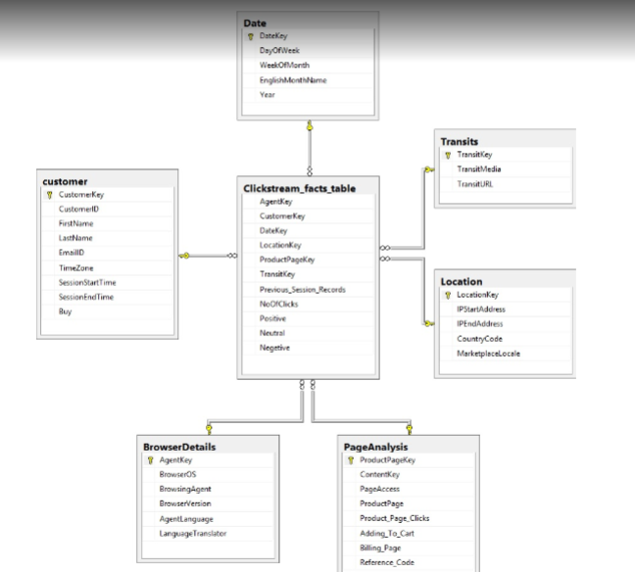
Star Schema

Slide 6
Software / Tools
Data Collection was done by web scrapping on several public open data websites using R Studio (rvest).
Cleaning and pre-processing required Google refine and R Studio.
Creating staging DB and data marts using SQL management studio and visual studio (Data tools).
ETL - SQL management studio.
Inner join - Visual studio (Query editor).
Deploying the cube - SQL management studio.
Finally, importing the DB to PowerBI for generating Business Intelligence reports.

Slide 7
Thank you for your time

